Slide 1
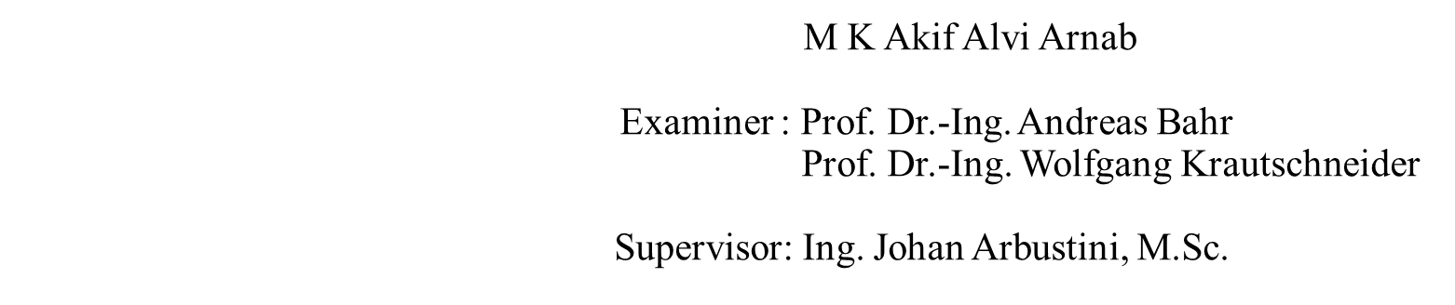

Slide 2
Topics Covered
Magneto-Electric Sensor and Amplifier Design Specifications
Electrical Noise
Design of the basic Single-Stage Amplifiers
Design of the 2-Stage, Differential and Folded Cascode Amplifiers
Lateral BJT Input-Stage Folded Cascode Amplifier for achieving lower input noise
Simulation Results of the Amplifier
Layout of the amplifier
Performance Comparison of the designed Amplifiers with Literature
Possible Improvements

Slide 3
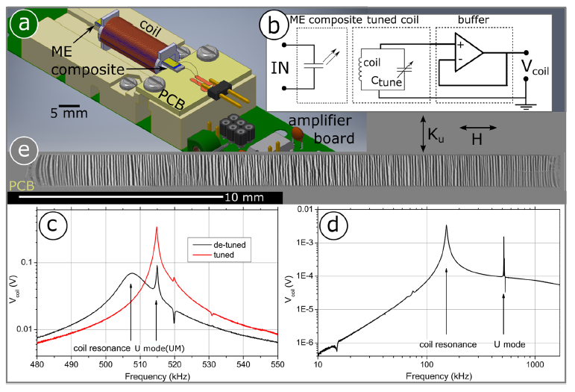
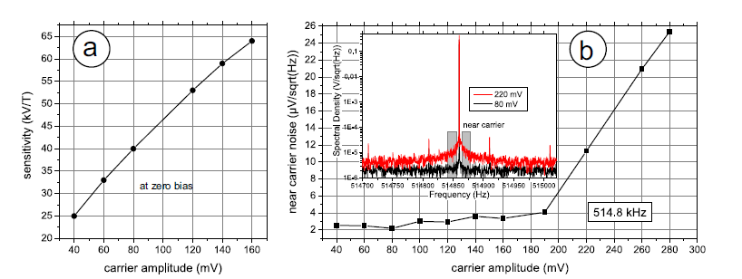
Magneto-Electric Sensor and Amplifier Design Specifications
Parameter | Value
VDD | 3.3V
Gain (single stage amplifiers) | 20dB
Gain ( Differential, 2-stage and folded cascode amplifiers) | 50dB
Gain-bandwidth (single stage amplifiers) | 25MHz
Gain-bandwidth ( Differential, 2-stage and folded cascode amplifiers) | 70MHz
C_{Load} | 1pF
Frequency of interest | 500KHz
Figure 1: Sensor setup and tuning
Table 1: Amplifier design specifications
Silicon-based magnetoelectric (ME) thin films fabricated at the Kiel Nanolaboratory
The mechanical resonance of interest at 515KHz
Carrier signal noise at the lowest amplitude is about 2μV /√Hz
Desired noise from the amplifier < 2μV /√Hz
Figure 2: Sensor sensitivity and noise dependency on the applied carrier amplitude

Slide 4
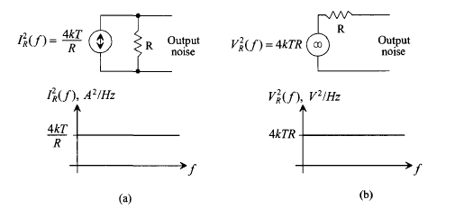
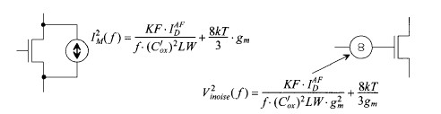
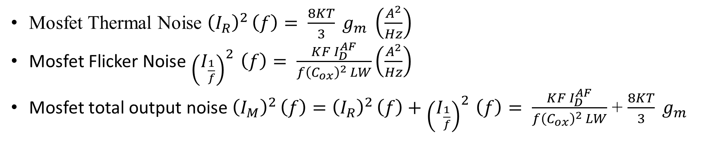
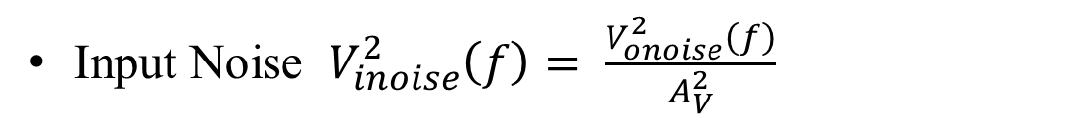
Electrical Noise
An unwanted voltage or current signal that affects power dissipation, speed, and linearity.
Mainly expressed by its mean-squared power or its root-mean-squared voltage/current.
Determined in the frequency domain based on the Power Spectral Density (PSD) plot.
Types of noises
Environmental Noise
Occurred by random disturbances a circuit experiences through the supply or ground lines or through the substrate
Device Electronic Noise
Thermal Noise
Flicker Noise
Shot Noise
Input-Referred Noise
The output noise doesn‘t allow a justifiable comparison of the performance of different circuits
The output noise is referred back to the input of the circuitry to compare to its input signal
Represents the effects of all noise sources in the circuitry by a single voltage source.
Figure 3: Thermal noise of a resistor in PSDs
Mosfet Thermal Noise ${\left(I_{R}\right)}^{2 }\left(f\right)= \frac{8KT}{3} g_{m} \left(\frac{A^{2}}{Hz}\right)$
Mosfet Flicker Noise ${\left(I_{\frac{1}{f}}\right)}^{2 }\left(f\right)= \frac{KF I_{D}^{AF}}{f{\left(C_{ox}\right)}^{2 }LW}\left(\frac{A^{2}}{Hz}\right)$
Mosfet total output noise ${\left(I_{M}\right)}^{2 }\left(f\right)={\left(I_{R}\right)}^{2 }\left(f\right)+{\left(I_{\frac{1}{f}}\right)}^{2 }\left(f\right)= \frac{KF I_{D}^{AF}}{f{\left(C_{ox}\right)}^{2 }LW}$ + $\frac{8KT}{3} g_{m}$
Input Noise $V_{inoise}^{2}\left(f\right)= \frac{V_{onoise}^{2}\left(f\right)}{A_{V}^{2}}$
Figure 4: Modeling mosfet noise current and input-referred noise voltage

Slide 5
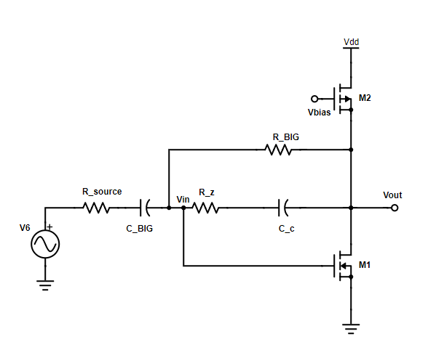
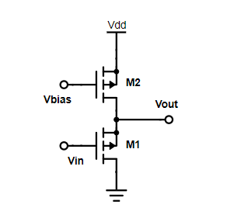
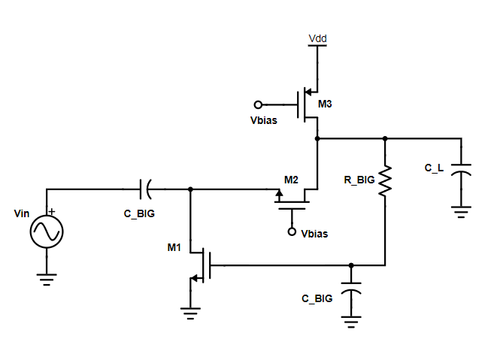
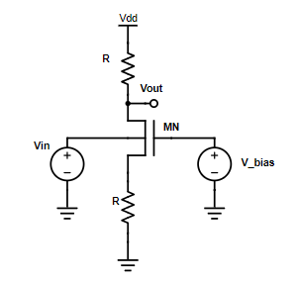
Basic Single-Stage Amplifiers
Amplifier | Ibias (μA) | Gain (dB) | PM (◦) | GBW (MHz) | IRN (V /√Hz)
Common-Source Amplifier | 1 | 20 | 89.7 | 25.36 | 108.147n
Common-Source Cascode Amplifier | 5 | 26.8 | 87.5 | 25.33 | 87.233n
Common-Gate Amplifier | 3.58 | 29 | 92.12 | 25.22 | 113.2364n
Common-Drain Amplifier | 1 | - | - | - | 1.30629μ
Common-Bulk Amplifier | R=920KΩ | - | - | - | 603.805n
Figure 5: Common-source amplifier
Figure 6: Common-drain amplifier
Table 2: Summary of the designed basic single stage amplifiers
Design considerations:
Similar minimum open-loop gain
Similar GBW
Tuning the transistors to operate in their desired region
Figure 7: Common-gate amplifier
Figure 8: Common-bulk amplifier

Slide 6
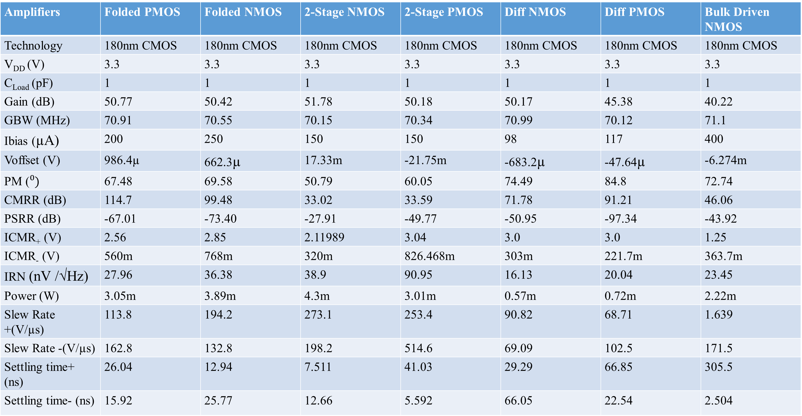
2-Stage, Differential and Folded Cascode Amplifiers
Amplifiers | Folded PMOS | Folded NMOS | 2-Stage NMOS | 2-Stage PMOS | Diff NMOS | Diff PMOS | Bulk Driven NMOS
Technology | 180nm CMOS | 180nm CMOS | 180nm CMOS | 180nm CMOS | 180nm CMOS | 180nm CMOS | 180nm CMOS
V_{DD} (V) | 3.3 | 3.3 | 3.3 | 3.3 | 3.3 | 3.3 | 3.3
C_{Load} (pF) | 1 | 1 | 1 | 1 | 1 | 1 | 1
Gain (dB) | 50.77 | 50.42 | 51.78 | 50.18 | 50.17 | 45.38 | 40.22
GBW (MHz) | 70.91 | 70.55 | 70.15 | 70.34 | 70.99 | 70.12 | 71.1
Ibias (µA) | 200 | 250 | 150 | 150 | 98 | 117 | 400
Voffset (V) | 986.4µ | 662.3µ | 17.33m | -21.75m | -683.2µ | -47.64µ | -6.274m
PM ($⁰)$ | 67.48 | 69.58 | 50.79 | 60.05 | 74.49 | 84.8 | 72.74
CMRR (dB) | 114.7 | 99.48 | 33.02 | 33.59 | 71.78 | 91.21 | 46.06
PSRR (dB) | -67.01 | -73.40 | -27.91 | -49.77 | -50.95 | -97.34 | -43.92
ICMR₊ (V) | 2.56 | 2.85 | 2.11989 | 3.04 | 3.0 | 3.0 | 1.25
ICMR₋ (V) | 560m | 768m | 320m | 826.468m | 303m | 221.7m | 363.7m
IRN (nV /√Hz) | 27.96 | 36.38 | 38.9 | 90.95 | 16.13 | 20.04 | 23.45
Power (W) | 3.05m | 3.89m | 4.3m | 3.01m | 0.57m | 0.72m | 2.22m
Slew Rate +(V/µs) | 113.8 | 194.2 | 273.1 | 253.4 | 90.82 | 68.71 | 1.639
Slew Rate -(V/µs) | 162.8 | 132.8 | 198.2 | 514.6 | 69.09 | 102.5 | 171.5
Settling time+ (ns) | 26.04 | 12.94 | 7.511 | 41.03 | 29.29 | 66.85 | 305.5
Settling time- (ns) | 15.92 | 25.77 | 12.66 | 5.592 | 66.05 | 22.54 | 2.504
Table 3: Performance summary of the designed amplifiers

Slide 7
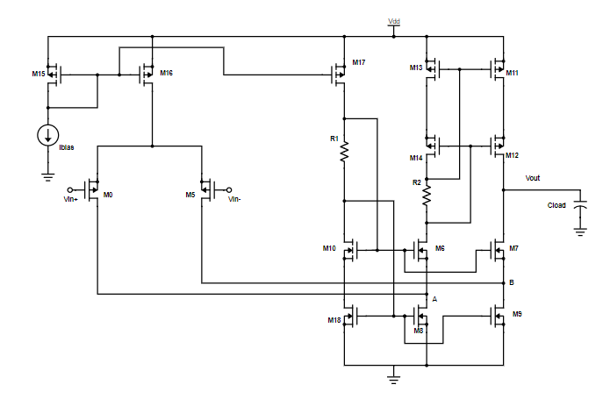
Folded Cascode Amplifier with PMOS Input Stage
Transistors | Width(W) | Length(L)
M0,M5 | 53µm | 1µm
M15,M16 | 33.85µm | 1µm
M17 | 42.31µm | 1µm
M13,M11 | 48µm | 1µm
M14 | 48µm | 1µm
M12 | 48µm | 1.04µm
M10,M6,M7 | 10µm | 1µm
M18,M8,M9 | 10µm | 1µm
Table 4: Transistor Sizes
Parameters | Values
Ibias | 200µA
Vcm | 1.5V
R0 | 2.8kΩ
R1 | 3.2kΩ
Advantages:
Input voltage swings around ground
Offers self-compensation
Gain similar to that of a 2-stage op-amp
R1 and R2 provide self-biasing for the cascode stages
𝑆𝑙𝑒𝑤 𝑟𝑎𝑡𝑒= 𝐼_16/𝐶_load
𝐺𝐵𝑊= 𝑔_(𝑚,0)/𝐶_𝐿
Table 5: Parameter Values

Slide 8
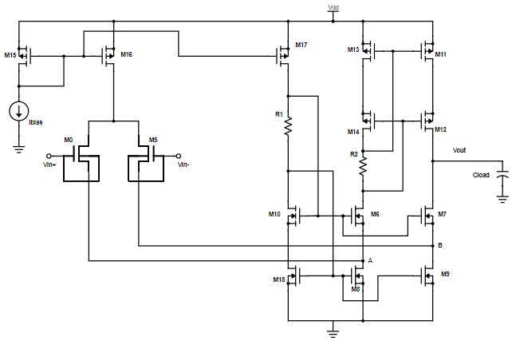
Lateral Bjt-Input Folded Cascode Amplifier
Enhanced Lateral P-N-P Bipolar Junction Transistor (BJT)
Connection of the gate and bulk terminal of a PMOS device operating in the subthreshold region.
Higher Transconductance for the lateral BJT input stage rather than ordinary PMOS input-stage of a differential amplifier [57].
Tend to generate lower flicker noise [57].
Transistors | Width(W) | Length(L) | Operating-Region
M0,M5 | 200µm | 350nm | Sub-threshold
M15,M16 | 33µm | 1µm | Saturation
M17 | 44µm | 1µm | Saturation
M13,M11 | 80µm | 1µm | Saturation
M14,M12 | 80µm | 1µm | Saturation
M10,M6,M7 | 30µm | 1µm | Saturation
M18,M8,M9 | 30µm | 1µm | Saturation
Table 6: Transistor Sizes
Parameters | Values
Ibias | 115µA
R2 | 2.8kΩ
R3 | 3.2kΩ
Table 7: Parameter Values
Figure 9: Schematic of the lateral bjt-input folded cascode op-amp

Slide 9
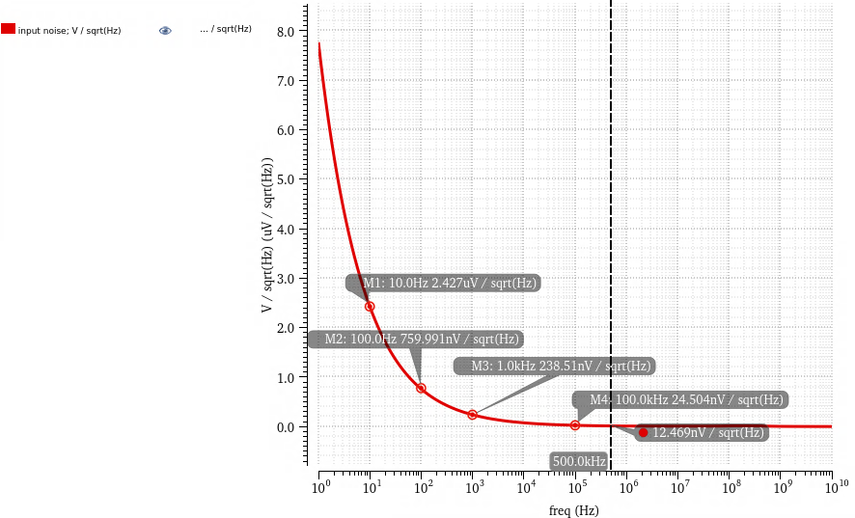
Lateral Bjt-Input Folded Cascode Amplifier
Folded Cascode Amplifier | Ordinary PMOS Input Stage | Lateral BJT Input Stage
Technology | 180nm CMOS | 180nm CMOS
VDD(V) | 3.3 | 3.3
C_{Load} (pF) | 1 | 1
Gain (dB) | 50.77 | 57.79
GBW (MHz) | 70.91 | 96.38
Ibias (μA) | 200 | 115
Voffset (V) | 986.4μ | -359.1μ
Phase Margin (◦) | 67.48 | 54.63
CMRR (dB) | 114.7 | 105.3
PSRR (dB) | -67.01 | -78.82
ICMR+ (V) | 2.56 | 2.83
ICMR- (V) | 560m | 320m
IRN (nV /√Hz) | 27.96@500KHz | 12.47@500KHz
Power Consumption | 3.05mW | 1.89mW
Slew Rate+ (V /μs) | 113.8 | 62.61
Slew Rate- (V /μs) | 162.8 | 73.02
Settling Time+ (ns) | 26.04 | 38.43
Settling Time- (ns) | 15.92 | 31.18
Figure 10: Input-referred noise at different frequencies
Frequency | Input-Referred Noise (V /√Hz)
10Hz | 2.427µ
100Hz | 759.991n
1kHz | 238.51n
100KHz | 24.504n
500KHz | 12.469n
Table 8: Input-referred noise at different frequencies
Table 9: Performance comparison of the folded-cascode amplifier with ordinary PMOS input stage and
lateral bjt input stage

Slide 10
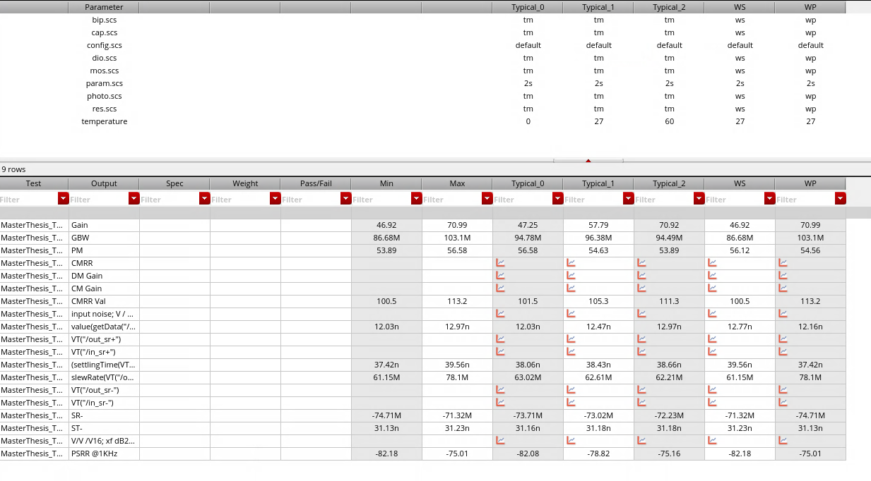
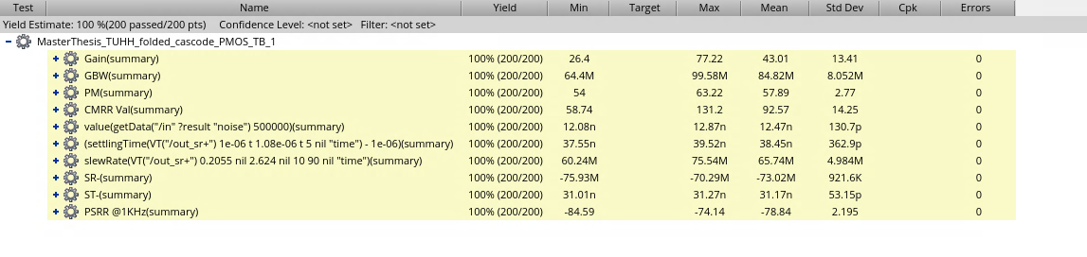
Lateral Bjt-Input Folded Cascode Amplifier
Temperatures 0°, 27°, 60°
Corners
Typical (normal NMOS normal PMOS)
WS(slow NMOS slow PMOS)
WP(fast NMOS fast PMOS)
Noise increases with increase of temperature (Thermal Noise depends on temperature)
Monte Carlo Mean value of IRN = 12.47nV /√Hz
Figure 11: Corner simulation results
Figure 12: Monte-Carlo simulation results

Slide 11
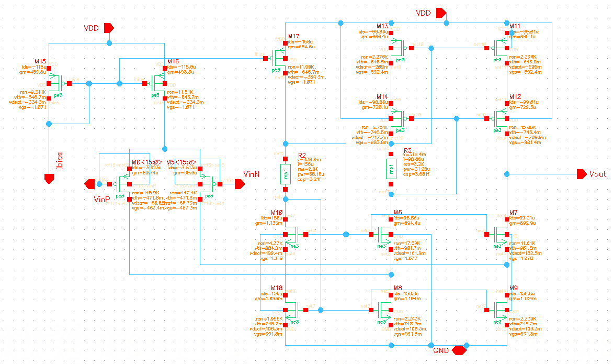
Lateral Bjt-Input Folded Cascode Amplifier
Matched Trasistors | Multiplier Ratio | Matching Technique | Matching Pattern
M15,M16,M17 | 6:6:8 | Common-Centroid | AAACCCCBBB BBBCCCCAAA
M13,M11 | 16:16 | Common-Centroid | ABBAABBA BAABBAAB BAABBAAB ABBAABBA
M14,M12 | 16:16 | Common-Centroid | Same as M13,M11
M10, M6,M7 | 12:12:12 | Common-Centroid | ABCCBAABC CBAABCCBA CBAABCCBA ABCCBAABC
M18, M8,M9 | 12:12:12 | Common-Centroid | Same as M10, M6,M7
Figure 13: Schematic of the lateral bjt-input folded cascode op-amp for layout
Transistors | Width(W) | Length(L) | Multiplier | W_total
M0,M5 | 12.5µm | 350nm | 16 | 200µm
M15,M16 | 5.5µm | 1µm | 6 | 33µm
M17 | 5.5µm | 1µm | 8 | 44µm
M13,M11 | 5.5µm | 1µm | 15 | 80µm
M14,M12 | 5.5µm | 1µm | 15 | 80µm
M10,M6,M7 | 2.5µm | 1µm | 12 | 30µm
M18,M8,M9 | 2.5µm | 1µm | 12 | 30µm
Table 11: Matching technique and pattern for the layout
Table 10: Dividing the transistors into multipliers for layout

Slide 12
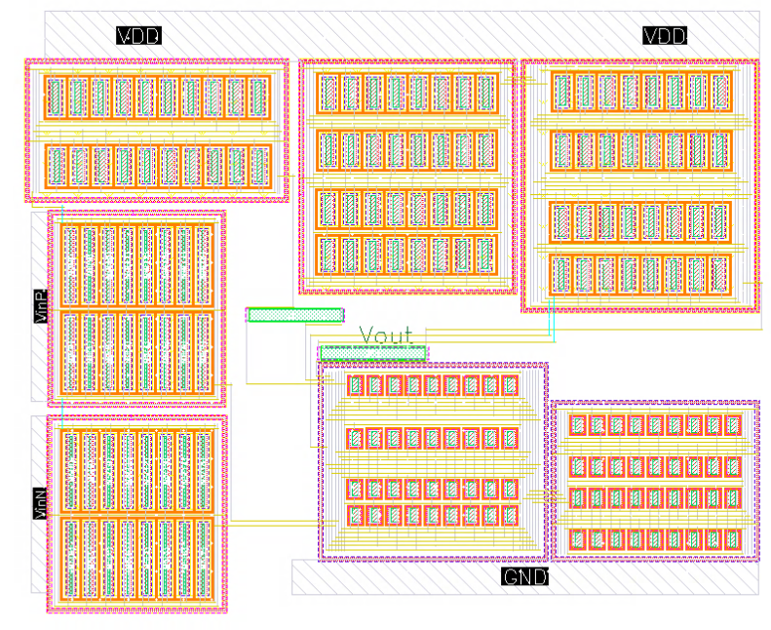
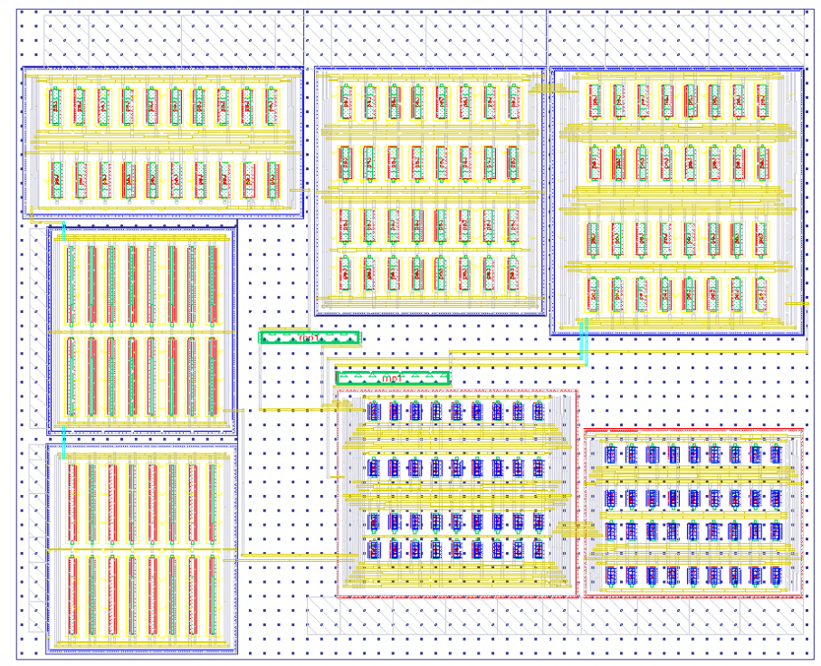
Lateral Bjt-Input Folded Cascode Amplifier
M15,M16,M17
M13,M11
M14,M12
M0
R2
R3
M18,M8, M9
M10,M6, M7
M5
Figure 14: Layout of the lateral bjt-input folded cascode amplifier
Figure 15: Parasitic extracted view of the layout
12

Slide 13
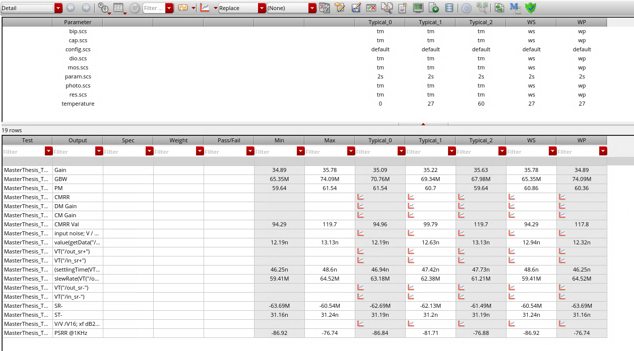
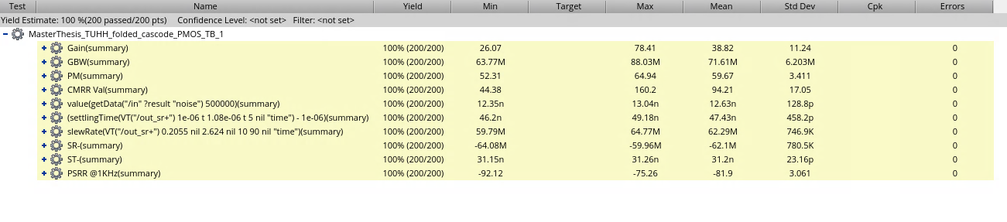
Lateral Bjt-Input Folded Cascode Amplifier
Monte-Carlo Simulation | Mean Values Pre-Layout | Mean Values Post-Layout
Gain(dB) | 43.01 | 38.82
GBW (MHz) | 84.82 | 71.61
Phase Margin (◦) | 57.89 | 59.67
CMRR (dB) | 92.57 | 94.21
PSRR (dB) | -78.84@1KHz | -81.9@1KHz
IRN (nV /√Hz) | 12.47@500KHz | 12.63@500KHz
Slew Rate+ (V /μs) | 65.74 | 62.29
Slew Rate- (V /μs) | 73.02 | 62.1
Settling Time+ (ns) | 38.45 | 47.43
Settling Time- (ns) | 31.17 | 31.2
Table 12: Comparison between the Monte-Carlo mean values from the pre-layout and post-layout simulations
Figure 16: Post-Layout Corner simulation results
Figure 17: Post-layout Monte-Carlo simulation results

Slide 14
Comparison with Literature
Folded Cascode Amplifiers | [14] | [68] | [71] | [57] | This work- Ordinary PMOS Input Stage | This work- Lateral BJT Input Stage
Technology (CMOS) | 180nm | 180nm | 180nm | 180nm | 180nm | 180nm
VDD (V) | 0.6 | 1.8 | 1.8 | 1.8 | 3.3 | 3.3
Gain(dB) | 62.78 | 79.47 | 73 | 86.8 | 50.77 | 57.79
GBW (Hz) | 136.7k | 285.85M | 247M | 110K | 70.91M | 96.38M
Phase Margin (◦) | 66.12 | 77.12 | 71 | 37 | 67.48 | 54.63
C_{Load} (pF) | 10 | 5 | 5 | 2.5 | 1 | 1
IRN | 2.69μV/√Hz @1Hz | 185.4μV/√Hz @(1Hz-100MHz) | 137μV/√Hz @(1Hz-100MHz) | 9.5 μVrms | 27.96 (nV/√Hz @500KHz) | 12.47 (nV/√Hz @500KHz)
Power (W) | 480n | >2.16m | >2.16m | 198n | 3.05m | 1.89m
CMRR (dB) | - | 70.8 | 84 | - | 114.7 | 105.3
PSRR (dB) | - | 41.6 | 74 | - | -67.01 | -78.82
FOM (MHz pF/mA) | 2228.37 | 3007.25 | 1725 | 1196.4 | 106.84 | 154.83
Table 13: Performance comparison of different folded cascode amplifiers with the PMOS Input-stage folded cascode amplifier designed in this work

Slide 15
Possible Improvements
Using Mosfets instead of resistors in the folded cascode amplifier
Biasing circuitry could be used
Fully Differential Approaches in the layout

Slide 16
Thank You
Notes:
The references used in the project have been really useful.

Slide 17
References
[1] "ATransistor Amplifiers (II) Other Amplifier Stages". url: https://web.mit.edu/6.012/www/SP07-
L20.pdf.
[2] "Characterizing the PSRR of Data Acquisition Module Devices with Internal Bypass Capacitors". url:
https://www.analog.com/en/analog-dialogue/articles/characterizing-the-psrr-of-dataacquisition-
umodule-devices-with-internal-bypass-capacitors.html.
[3] "CMOS amplifier". url: https://en.wikipedia.org/wiki/CMOS_amplifier.
[4] "Common-mode rejection ratio". url: https://en.wikipedia.org/wiki/Common-mode_rejection_
ratio.
[5] "F. Maloberti Layout of Analog CMOS Integrated Circuit Part 2 Transistors and Basic Cells Layout".
url: http://ims.unipv.it/Courses/download/AIC/Layout02.pdf.
[6] "How to Measure the Power Supply Rejection Ratio for the MAX38902A/MAX38902B". url: https:
//www.analog.com/en/technical-articles/how-to-measure-the-power-supply-rejectionratio-
for-the-max38902amax38902b.html.
[7] "LDO PSRR Measurement Simplified". url: https://www.ti.com/lit/ml/slaa414a/slaa414a.pdf?
ts=1679905351802&ref_url=.
[8] "Op-Amp Power Supply Rejection Ratio". url: https://www.allaboutelectronics.org/op-amppower-
supply-rejection-ratio/.
[9] "What is PSRR and why is it important in op amps and LDOs?". url: https://www.analogictips.
com/what-is-pssr-and-why-is-it-important-in-op-amps-and-ldos-faq/.
[10] "What is Slew Rate : Working Its Applications". url: https://www.elprocus.com/slew-rate/.
[11] "Why CMRR and PSRR Matter When Choosing Op-Amps". url: https://www.arrow.com/en/
research-and-events/articles/why-cmrr-and-psrr-matter-when-choosing-op-amps?.
[12] 2Kuldeep Ranav 1Ashita Anand. "Utility of Bulk Driven MOSFET for Low Voltage Analog Design".
url: https://www.jetir.org/papers/JETIR1808978.pdf.
[13] Asad A Abidi. “High-frequency noise measurements on FET’s with small dimensions”. inIEEE
Transactions on electron devices: 33.11 (1986), pages 1801–1805.
[14] Meysam Akbari, Sadegh Biabanifard and Omid Hashemipour. “Design of ultra-low-power CMOS
amplifiers based on flicker noise reduction”. in2014 22nd Iranian conference on electrical engineering
(ICEE): IEEE. 2014, pages 403–406.
[15] Meysam Akbari, Omid Hashemipour and Ardavan Javid. “An ultra-low voltage, ultra-low power fully
recycling folded cascode amplifier”. in2014 22nd Iranian Conference on Electrical Engineering (ICEE):
IEEE. 2014, pages 514–518.
[16] Phillip E Allen and Douglas R Holberg. CMOS analog circuit design. Elsevier, 2011.
[17] G.A. Rincon-Mora B. J. Blalock P. E. Allen. “Designing 1-V op amps using standard digital CMOS
technology”. inIEEE Transactions on Circuits and Systems II: Analog and Digital Signal Processing:
45.7 (1998), pages 769–780.
[18] R Jacob Baker. CMOS: circuit design, layout, and simulation. John Wiley & Sons, 2019.
[19] Andrea Bevilacqua and Ali M Niknejad. “An ultrawideband CMOS low-noise amplifier for 3.1-10.6-GHz
wireless receivers”. inIEEE Journal of solid-state circuits: 39.12 (2004), pages 2259–2268.
[20] Stephan C Blaakmeer andothers. “Wideband balun-LNA with simultaneous output balancing, noisecanceling
and distortion-canceling”. inIEEE journal of solid-state circuits: 43.6 (2008), pages 1341–1350.
[21] Benjamin J Blalock and Phillip E Allen. “A low-voltage, bulk-driven MOSFET current mirror for
CMOS technology”. inProceedings of ISCAS’95-International Symposium on Circuits and Systems:
volume 3. IEEE. 1995, pages 1972–1975.
[22] Federico Bruccoleri, Eric AM Klumperink and Bram Nauta. “Wide-band CMOS low-noise amplifier
exploiting thermal noise canceling”. inIEEE journal of solid-state circuits: 39.2 (2004), pages 275–282.
[23] Ke-Hou Chen and Shen-Iuan Liu. “Inductorless wideband CMOS low-noise amplifiers using noisecanceling
technique”. inIEEE Transactions on Circuits and Systems I: Regular Papers: 59.2 (2011),
pages 305–314.
[24] Ke-Hou Chen andothers. “An Ultra-Wide-Band 0.4–10-GHz LNA in 0.18 μm CMOS”. inIEEE
Transactions on Circuits and Systems II: Express Briefs: 54.3 (2007), pages 217–221.
[25] Yi-Jan Emery Chen and Yao-I Huang. “Development of integrated broad-band CMOS low-noise
amplifiers”. inIEEE Transactions on Circuits and Systems I: Regular Papers: 54.10 (2007), pages 2120–2127.
[26] Paul R Gray and Robert G Meyer. “MOS operational amplifier design-a tutorial overview”. inIeee
journal of solid-state circuits: 17.6 (1982), pages 969–982.
[27] Lipika Gupta, Amod Kumar and Sartajvir Singh. “G m/I D Method based Low-power, Low-noise Preamplifier
Design for EEG”. in2019 International Conference on Computing, Power and Communication
Technologies (GUCON): IEEE. 2019, pages 82–88.
[28] Priti Gupta and Suman Lata Tripathi. “Low power design of bulk driven operational transconductance
amplifier”. in2017 Devices for Integrated Circuit (DevIC): IEEE. 2017, pages 241–246.
[29] Reid R Harrison and Cameron Charles. “A low-power low-noise CMOS amplifier for neural recording
applications”. inIEEE Journal of solid-state circuits: 38.6 (2003), pages 958–965.
Notes:
The references used in the project have been really useful.

Slide 18
References
[30] Patrick Hayes andothers. “Converse magnetoelectric composite resonator for sensing small magnetic
fields”. inScientific reports: 9.1 (2019), page 16355.
[31] Payam Heydari. “Design and analysis of a performance-optimized CMOS UWB distributed LNA”.
inIEEE Journal of Solid-State Circuits: 42.9 (2007), pages 1892–1905.
[32] Institute for Integrated Circuits, Hamburg University of Technology. "ACDLab_WS1920_T02_opamp_analysis".
University Lecture. 2019-20.
[33] Aly Ismail and Asad A Abidi. “A 3-10-GHz low-noise amplifier with wideband LC-ladder matching
network”. inIEEE Journal of solid-state circuits: 39.12 (2004), pages 2269–2277.
[34] Chih-Fan Liao and Shen-Iuan Liu. “A broadband noise-canceling CMOS LNA for 3.1–10.6-GHz UWB
receivers”. inIEEE Journal of Solid-State Circuits: 42.2 (2007), pages 329–339.
[35] Kuang Hao Lin, Tai Hsuan Yang and Chen Wei Hsu. “Implementation of a low-power folded-cascode RF
front-end for LTE receivers”. in2014 International Symposium on Computer, Consumer and Control:
IEEE. 2014, pages 1049–1052.
[36] Zheng Liu and Lihong Zhang. “Performance-constrained parasitic-aware retargeting and optimization
of analog layouts”. in2009 Canadian Conference on Electrical and Computer Engineering: IEEE. 2009,
pages 1194–1197.
[37] Ali Meaamar andothers. “A wideband low power low-noise amplifier in CMOS technology”. inIEEE
transactions on Circuits and Systems I: Regular papers: 57.4 (2009), pages 773–782.
[38] Trung-Kien Nguyen andothers. “CMOS low-noise amplifier design optimization techniques”. inIEEE
Transactions on microwave theory and techniques: 52.5 (2004), pages 1433–1442.
[39] Jack Ou and Pietro M Ferreira. “A g_{m}/I_{D}-based noise optimization for CMOS folded-cascode
operational amplifier”. inIEEE Transactions on Circuits and Systems II: Express Briefs: 61.10 (2014),
pages 783–787.
[40] Domenico Pepe and Domenico Zito. “22.7-dB Gain 19.7-dBm UWB CMOS LNA”. inIEEE Transactions
on Circuits and Systems II: Express Briefs: 56.9 (2009), pages 689–693.
[41] Michael H. Perrott. "Analysis and Design of Analog Integrated Circuits Lecture 16 Subthreshold Operation
and gm/Id Design". url: https://www.cppsim.com/CircuitLectures/Lecture16.pdf.
[42] Prof. Dr. Ing. Andreas Bahr, Institute for Integrated Circuits, Hamburg University of Technology.
"Integrated Circuit Design previously Electronic Devices and Circuits, Chapter 6 : Electrical Noise".
University Lecture. 2023.
[43] Prof. Dr.-Ing. Matthias Kuhl, Institute for Integrated Circuits, Hamburg University of Technology.
"ACDLabWS1920T 03opampsimulations.pdf”. University Lecture. 2019.
[44] Prof. Dr.-Ing. Matthias Kuhl, Institute for Integrated Circuits, Hamburg University of Technology.
"Chapter 1: MOS Transistors". University Lecture. 2020.
[45] Prof. Dr.-Ing. Matthias Kuhl, Institute for Integrated Circuits, Hamburg University of Technology.
"Chapter 3: MOS Amplifiers - From Common Source to Differential Stages ". University Lecture. 2020.
[46] Prof. Dr.-Ing. Matthias Kuhl, Institute for Integrated Circuits, Hamburg University of Technology.
"Chapter 4: Operational Amplifiers – From Single Stage to Two Stage –". University Lecture. 2020.
[47] Yasir Mahmood Qureshi. “Design and layout of two stage high bandwidth operational amplifier”.
inWorld Academy of Science, Engineering and Technology: 71 (2012).
[48] V Sudheer Raja and S Kumaravel. “Design of recycling folded cascode amplifier using potential
distribution method”. in2017 International conference on Microelectronic Devices, Circuits and Systems
(ICMDCS): IEEE. 2017, pages 1–5.
[49] Shraddha Rathore and Anand D Darji. “Minimum area layout of high bandwidth folded cascode
operational amplifier using SCL 180nm CMOS technology”. in2017 International Conference on
Information, Communication, Instrumentation and Control (ICICIC): IEEE. 2017, pages 1–6.
[50] Behzad Razavi. Design of analog CMOS integrated circuits., 2005.
[51] Michael T Reiha and John R Long. “A 1.2 V reactive-feedback 3.1–10.6 GHz low-noise amplifier in
0.13μm CMOS”. inIEEE Journal of Solid-State Circuits: 42.5 (2007), pages 1023–1033.
[52] Robert Rieger andothers. “Design of a low-noise preamplifier for nerve cuff electrode recording”.
inIEEE Journal of Solid-State Circuits: 38.8 (2003), pages 1373–1379.
[53] CS Sajin, SS Ajitha and TA Shahul Hameed. “Simulation of folded cascode amplifiers for high frequency
applications using sub threshold MOS”. inAIP Conference Proceedings: volume 2222. 1. AIP Publishing
LLC. 2020, page 020015.
[54] Willy MC Sansen and Willy Sansen. “Systematic Design of Operational Amplifiers”. inAnalog Design
Essentials: (2006), pages 181–209.
[55] Giuseppina Sapone and Giuseppe Palmisano. “A 3–10-GHz low-power CMOS low-noise amplifier for
ultra-wideband communication”. inIEEE Transactions on Microwave Theory and Techniques: 59.3
(2010), pages 678–686.
[56] Giuseppina Sapone and Giuseppe Palmisano. “A low-power 3-5-GHz UWB down-converter with
resistive-feedback LNA in a 90-nm CMOS process”. in2008 European Microwave Integrated Circuit
Conference: IEEE. 2008, pages 406–409.
[57] Chutham Sawigun and Prajuab Pawarangkoon. “Performance enhancement of a subthreshold MOS
folded-cascode OTA using enhanced lateral BJT input stage”. in2017 14th International Conference
on Electrical Engineering/Electronics, Computer, Telecommunications and Information Technology
(ECTI-CON): IEEE. 2017, pages 710–713.
[58] Jose E. Schutt-Aine. "ECE 342, Electronic Circuits, Lecture 25 Frequency Response of CG, CB,SF and
EF". url: http://emlab.uiuc.edu/ece342/notes/Lec_25.pdf.
[59] Derek K Shaeffer and Thomas H Lee. “A 1.5-V, 1.5-GHz CMOS low noise amplifier”. inIEEE Journal
of solid-state circuits: 32.5 (1997), pages 745–759.
[60] Sebastian Simmich, Andreas Bahr and Robert Rieger. “Noise efficient integrated amplifier designs for
biomedical applications”. inElectronics: 10.13 (2021), page 1522.
Notes:
The references used in the project have been really useful.

Slide 19
References
[61] Lee Cha Sing andothers. “Design and analysis of folded cascode operational amplifier using 0.13
μm CMOS technology”. inAIP Conference Proceedings: volume 2203. 1. AIP Publishing LLC. 2020,
page 020041.
[62] Cristian Stancu, Dragos Dobrescu and Lidia Dobrescu. “Offset Voltage Reduction Methods for a Two-
Stage Folded Cascode Operational Amplifier”. in2022 14th International Conference on Electronics,
Computers and Artificial Intelligence (ECAI): IEEE. 2022, pages 1–4.
[63] Bruno Stefanelli andothers. “A very low-noise CMOS preamplifier for capacitive sensors”. inIEEE
journal of solid-state circuits: 28.9 (1993), pages 971–978.
[64] B Telkes. “SETTLING TIME OF OPERATIONAL AMPLIFIERS WITH FEEDFORW ARD
COMPENSATION”. inPeriodica Polytechnica Electrical Engineering (Archives): 19.4 (1975), pages 329–348.
[65] Edgar Sánchez-Sinencio Texas AM University Department of Electrical Engineering. "Bulk Driven
Transistors". url: https://people.engr.tamu.edu/s-sanchez/ee689.html.
[66] Lee H Thomas. The design of CMOS radio-frequency integrated circuits. Cambridge University Press,
2004.
[67] Yannis Tsividis. Operation and Modeling of the MOS Transistor. McGraw-Hill, Inc., 1987.
[68] Sudheer Raja Venishetty and Kumaravel Sundaram. “Design and analysis of modified recycling folded
cascode amplifier with improved transconductance and slew rate”. inEngineering and Applied Science
Research: 47.4 (2020), pages 430–438.
[69] Sophie Verdonckt-Vandebroek andothers. “High-gain lateral bipolar action in a MOSFET structure”.
inIEEE Transactions on Electron Devices: 38.11 (1991), pages 2487–2496.
[70] Ender Yilmaz and GÜnhan Dundar. “Analog layout generator for CMOS circuits”. inIEEE Transactions
on computer-aided design of integrated circuits and systems: 28.1 (2008), pages 32–45.
[71] Ghader Yosefi. “The high recycling folded cascode (HRFC): A general enhancement of the recycling
folded cascode operational amplifier”. inMicroelectronics journal: 89 (2019), pages 70–90.
[72] Hirokazu Yoshizawa. “An improved figure-of-merit equation for op-amp evaluation”. inIEICE Electronics
Express: 12.15 (2015), pages 20150533–20150533.
[73] Yueh-Hua Yu, Yi-Jan Emery Chen and Deukhyoun Heo. “A 0.6-v low power uwb cmos lna”. inIEEE
microwave and wireless components letters: 17.3 (2007), pages 229–231.
[74] Frank Zhang and Peter R Kinget. “Low-power programmable gain CMOS distributed LNA”. inIEEE
Journal of Solid-State Circuits: 41.6 (2006), pages 1333–1343.
[75] Heng Zhang, Xiaohua Fan and Edgar Sánchez Sinencio. “A low-power, linearized, ultra-wideband LNA
design technique”. inIEEE Journal of solid-state circuits: 44.2 (2009), pages 320–330.
[76] Liang Zuo. “Low-voltage bulk-driven amplifier design and its application in implantable biomedical
sensors”. in(2012).
Notes:
The references used in the project have been really useful.

